Slide 1



Data analysis case study
NSW GOVERNMENT

Slide 2


In The Up Coming Slides We Are Going To See The Analysis According To The Requirements.

Slide 3
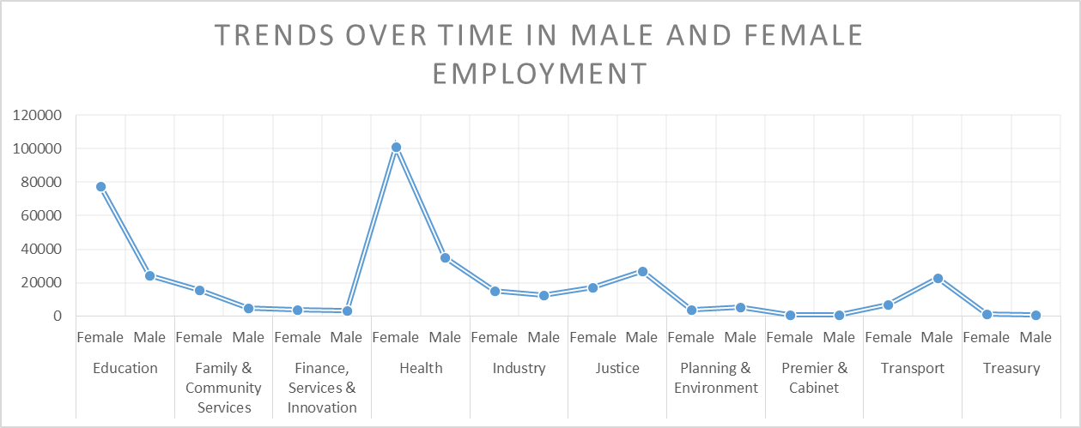
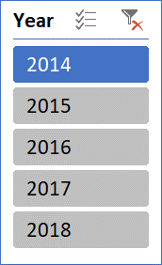
PROVIDED DATASET – Dataset
Now we have to find the below conditions .
Trends over time in male and female employment -

Slide 4
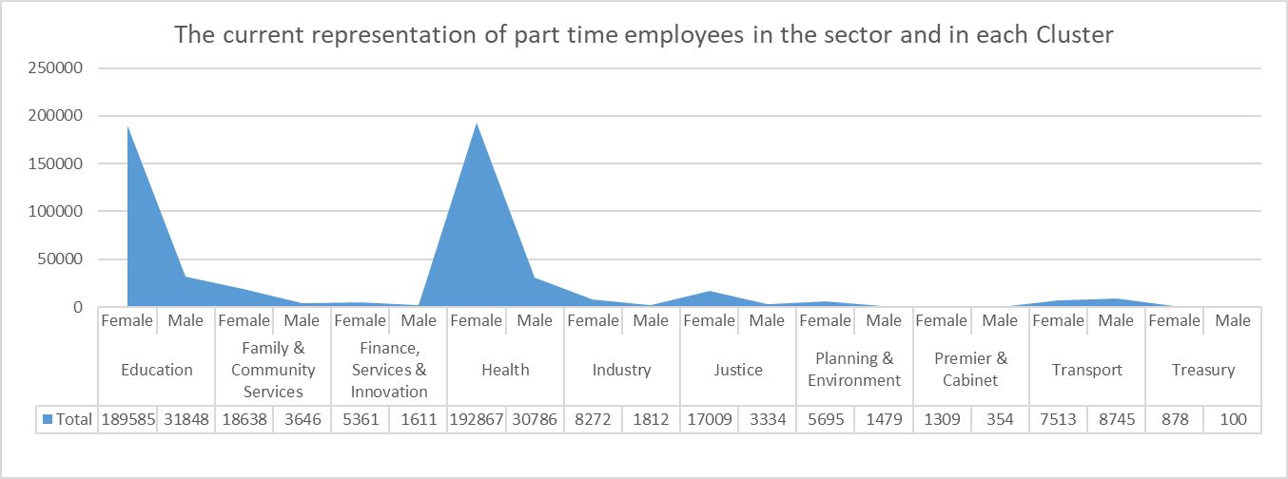
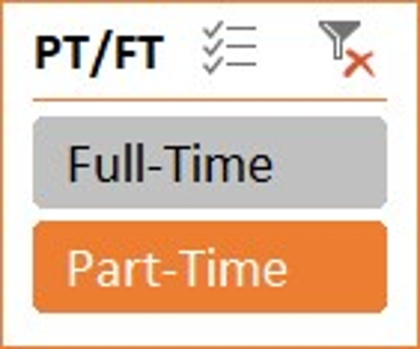
The current representation of part time employees in the sector and in each Cluster-

Slide 5
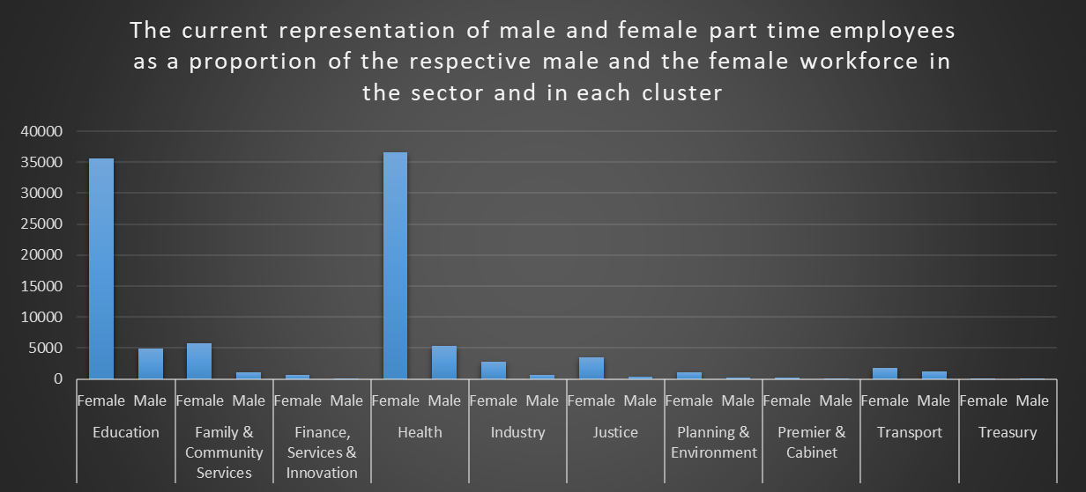
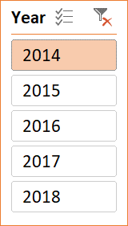
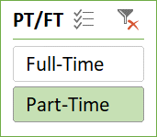
The current representation of male and female part time employees as a proportion of the respective male and the female workforce in the sector and in each cluster -

Slide 6
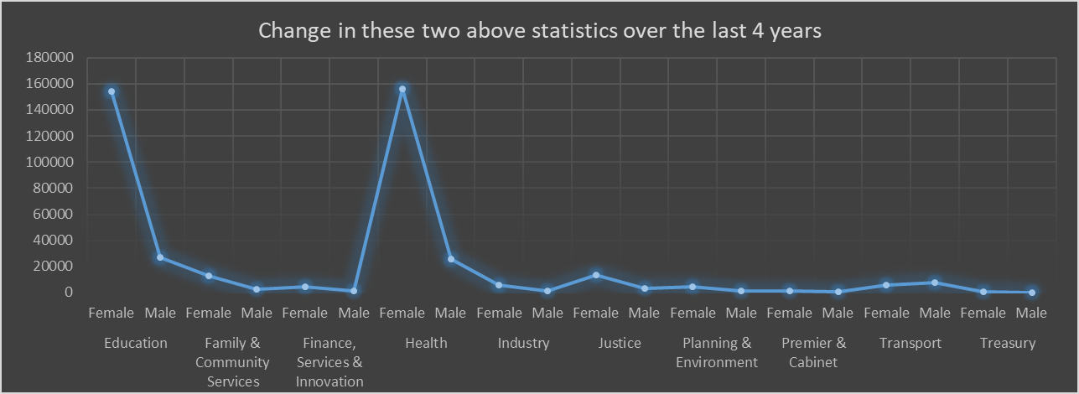
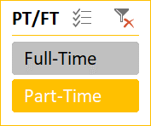
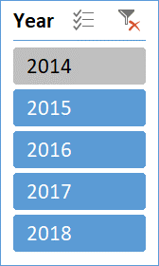
Change in these two above statistics over the last 4 years -

Slide 7
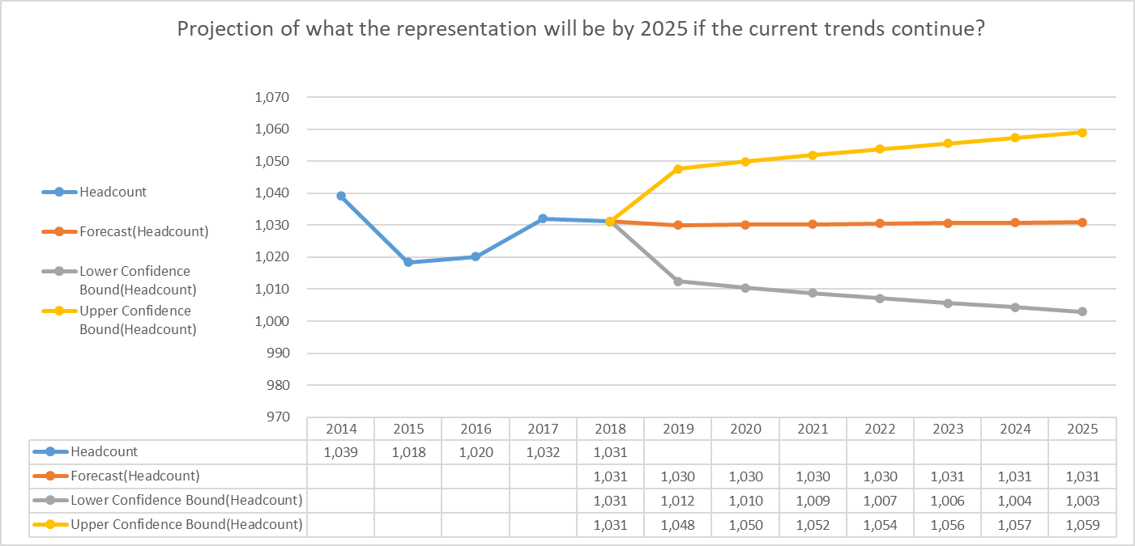
Now its time to find the last condition below. Projection of what the representation will be by 2025 if the current trends continue? -

Slide 8


